Slide 1

Database Systems
Vanier College
Entity Relationship (ER) Modeling

Slide 2
A database is an electronic store of data. It is a repository that stores information about different “objects” or “things” called Entities and contains relationships among them.
Entities are specific objects or things in the mini-world that are represented in the database.
Something that can be identified and the users want to track (we need to store data about):
Examples of entities:
Person: Employee, Student, Patient,.. Place: Store, Building,..
Object: Machine, product, Car,… Event: Sale, Registration, Renewal,…
Concept: Account, Course,..

Slide 3
Each entity can be described by its characteristics which are known as
Attributes, for example: an EMPLOYEE entity may have a Name, SSN, Address, gender, BirthDate,…
  A specific entity will have a value for each of its attributes. For example, a specific employee entity may have Name='John Smith', SSN='123456789’.
  Each attribute has a value set (or data type) associated with it – e.g., integer, Character, or …
  Required attribute: must have a value and cannot be left empty.
  Optional attribute: does not require a value and can be left empty.
Entities with the same basic attributes are grouped to form an Entity Set. An Entity Set is given a singular name:
The STUDENT entity set contains data about students only. All related entities in the STUDENT entity set are students.
Similarly, a company keeps track of all its employees in an entity set called EMPLOYEE. The EMPLOYEE entity set does not contain information about the company’s customers.

Slide 4
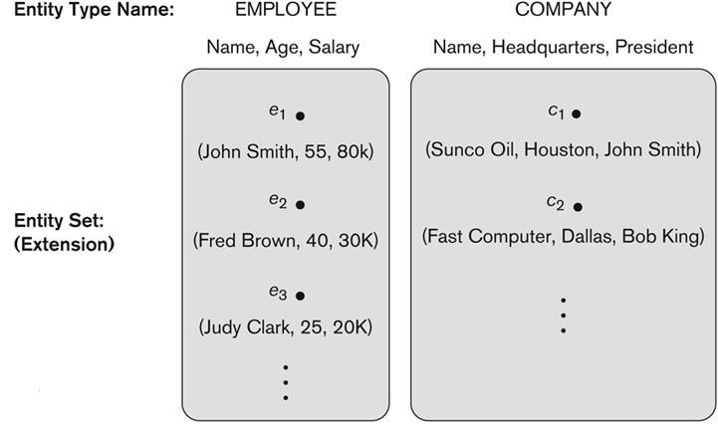

Slide 5
A database is a collection of entity sets, for example, a college’s database may include information about entities such as student, faculty, course, score, building, and so on.
The database design requires to create entity sets, each describing a set of related entities.
The design also requires to establish all the relationships between the entity sets within the database.
Entities can be associated with one another in relationships.
A relationship relates two or more distinct entities with a specific meaning, for example, EMPLOYEE John Smith works on the ProductX PROJECT, or EMPLOYEE Franklin Wong manages the Research DEPARTMENT
Depending on the type of interaction, the relationships are classified into three categories:
One-to-one (1:1)
One-to-many (1:M)
Many-to-many (N:M)

Slide 6
Relationships
One-to-Many relationship:
A one-to-many relationship exists between two entity sets, X and Y, if an entity in entity set X has many matching entities in entity set Y but an entity in entity set Y has only one matching entity in entity set X.
X
Y
For example
  Many employee works in one department, but one employee cannot work in many departments.
1-to Many

Slide 7
Relationships
One-to-One relationship:
A one-to-one relationship exists between two entity sets, X and Y, if an entity in entity set X has only one matching entity in entity set Y, and vice versa.
For example,
  A department in a college has one chairperson and a chairperson chairs one department in a college.
  Each student must complete one worksheet
(and the worksheet can only be completed by one student).
X
Y
1-to-1

Slide 8
Relationships
Many-to-Many relationship:
A many-to-many relationship exists between two entity sets, X and Y, if an entity in entity set X has many matching entities in entity set Y and an entity in entity set Y has many matching entities in entity set X.
X
Y
For example
  A student takes many courses, and many students take a course.
  An employee works on many projects, and a project has many employees.
Many-to-Many

Slide 9
Relationships Examples
A customer's order may contain one or more products; and a product can appear in many orders.
A teacher may teach more classes, while a class is taught by one teacher.
In a "company" database, a manager manages more employees, while an employee is managed by one manager.
In a "product sales" database, a customer may place many orders; while an order is placed by one particular customer.
An academic department is chaired by one professor; a professor may chair only one academic department.
A customer may generate many invoices; each invoice is generated by one customer.

Slide 10
Database Design
Before we look at how to create and manage a database, we’ll look at how to design one. We need to consider
– What tables, columns, keys, and constraints are needed?
Design Phases
  Conceptual design
    Build a model independent of the choice of DBMS
    We identify the entities, attributes and relationships among the entities.
  Logical design
    Consists of transforming the conceptual design into Relational data model
  Physical design
    We will create SQL statements for creating database tables, views, insert data, create stored procedures, etc.

Slide 11
The Importance of Data Model
A model is a simplified version of real-life complex objects.
– Useful in understanding complexities of the real-world environment
Data modeling is a technique to document a software system using diagrams and symbols.
A data model is a plan or blueprint for a database design.
Database designer uses data models to facilitate the interaction among designers, application programmers, and end users.

Slide 12
Entity Relationship model (ERM)
The highest level of abstraction for the data model is called Entity Relationship model (ERM).
An Entity-Relationship Model is the most common used model for relational database design.
ER models are normally represented in a diagram called as an Entity Relationship Diagram(ER Diagram or in short ERD). ERD is graphical symbols that can be used to create conceptual schemas and model database components..

Slide 13
Entity Relationship model (ERM).
The ER process starts, like most software-engineering projects, with obtaining requirements from users:
What data needs to be kept, what queries need to be asked, and what business rules do we build in
An ERD contains different symbols and connectors that visualize two important information: The major entities within the system scope, and the inter-relationships between these entities.

Slide 14
Why Do You Need an ER Diagram?
An entity-relationship diagram is essential for modeling the data stored in a database.
It represents the data in a graphical manner. This makes it easier to understand
  It’s used as an excellent communication tool.
  It improves interaction among the managers, the designers, and the end users.
  By drawing ER diagram to visualize database design ideas, we have a chance to identify the mistakes and design flaws, and to make corrections before executing the changes in the database.
  We can use tools represent the design in ER Diagram. CHEN and Crow Foot are popular notations.

Slide 15
The Entity Relationship Model (ERM)
ER model forms the basis of an ER diagram
ERD represents conceptual database as viewed by end user
ERDs depict database’s main components:
  Entities
  Attributes
  Relationships

Slide 16
Entities
Refers to entity set and not to single entity occurrence,
Corresponds to table and not to row in relational environment,
In Chen and Crow’s Foot models, entity is represented by rectangle with entity’s name,
The entity name, a noun, is written in capital letters.

Slide 17
Attributes
Characteristics of entities.
Chen notation: attributes represented by ovals connected to entity rectangle with a line.
  Each oval contains the name of attribute it represents.
Crow’s Foot notation: attributes written in attribute box below entity rectangle.

Slide 18
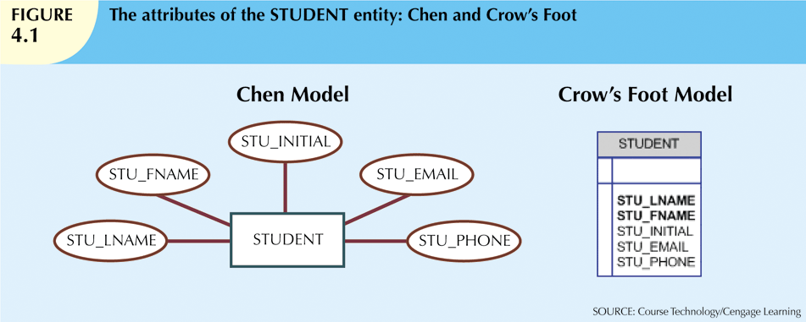

Slide 19
Attributes (cont’d.)
Required attribute: must have a value
Optional attribute: may be left empty
Domain: set of possible values for an attribute
  Attributes may share a domain
Identifiers: one or more attributes that uniquely identify each entity instance
Composite identifier: primary key composed of more than one attribute

Slide 20
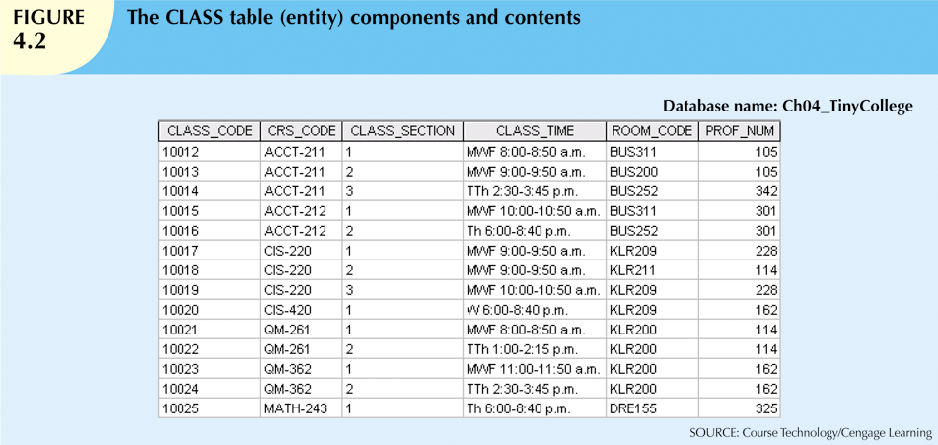

Slide 21
Attributes (cont’d.)
Composite attribute can be subdivided.
Simple attribute cannot be subdivided.
Single-value attribute can have only a single value.
Multivalued attributes can have many values.

Slide 22
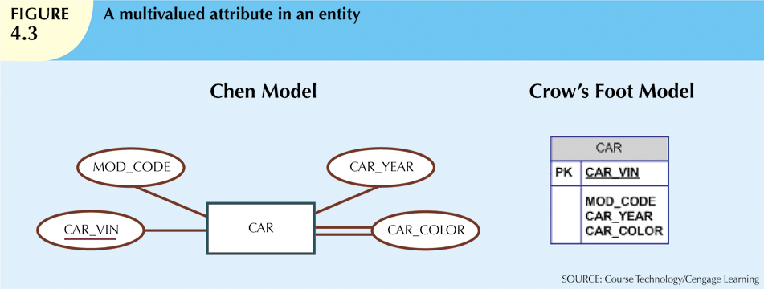

Slide 23
Attributes (cont’d.)
M:N relationships and multivalued attributes should not be implemented.
  Create several new attributes for each of the original multivalued attributes’ components.
  Create new entity composed of original multivalued attributes’ components.
Derived attribute: value may be calculated from other attributes.
  Need not be physically stored within database.

Slide 24
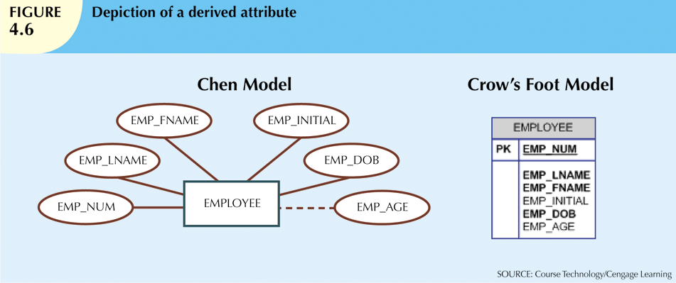

Slide 25
Relationships
Association between entities
Participants are entities that participate in a relationship
Relationships between entities always operate in both directions
Relationship can be classified as 1:M
Relationship classification is difficult to establish if only one side of the relationship is known

Slide 26
Connectivity and Cardinality
Connectivity
  Describes the relationship classification
Cardinality
  Expresses minimum and maximum number of entity occurrences associated with one occurrence of related entity
Established by very concise statements known as business rules

Slide 27
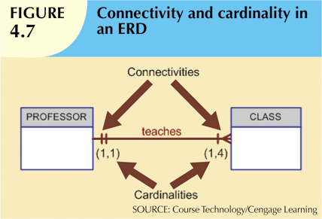

Slide 28
Existence Dependence
Existence dependence
  Entity exists in database only when it is associated with another related entity occurrence.
Existence independence
  Entity can exist apart from one or more related entities.
  Sometimes such an entity is referred to as a strong or regular entity.

Slide 29
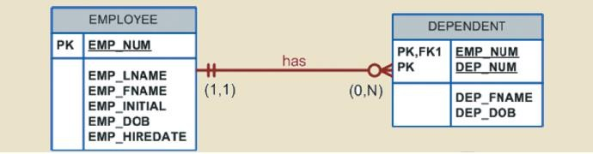
Weak Entities
A weak entity is an entity whose existence depends upon another entity.
It has a PK that is partially derived from the parent entity
Example:
  A company insurance policy insures an employee and any dependents, the DEPENDENT cannot exist without the EMPLOYEE; DEPENDENT is the weak entity in the relationship "EMPLOYEE has DEPENDENT"
  DEPENDENT is a weak entity type

Slide 30
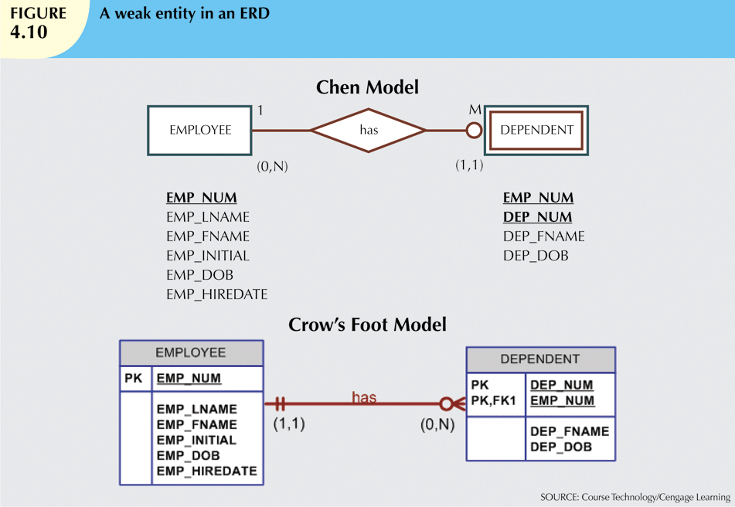

Slide 31
Relationship Participation
An entity set may participate in a relation either Optional or Mandatory.
Mandatory participation:
  means that every entity in the set is involved in the relationship, e.g., each student must be guided by a professor (there are no students who are not guided by any professor).
  It is indicated by placing a vertical hash mark next to the required entity.
Optional participation
  means that not all entities in the set are involved in the relationship, e.g., not every professor guides a student (there are professors who don’t). It is indicated by placing an oval next to the optional entity.

Slide 32
Participation Examples
Mandatory for both entities:
  A member of staff must be assigned to a given department, and any department must have staff. There can be no unassigned staff, and it is not possible to have an 'empty' department.
Mandatory for one entity, optional for the other:
  Any member of staff must be attached to a department, but it is possible for a department to have no staff allocated.
Optional for one entity, mandatory for the other:
  A member of staff does not have to be placed in a department, but all departments must have at least one member of staff.
Optional for both entities:
  A member of staff might be assigned to work in a department, but this is not compulsory. A department might, or might not, have staff allocated to work within it.

Slide 33
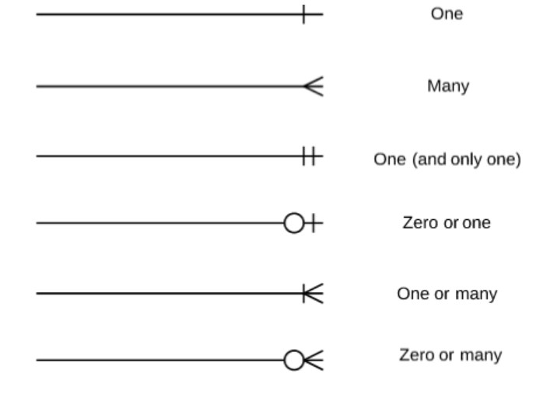
Participation Notation - Crow’s Model

Slide 34
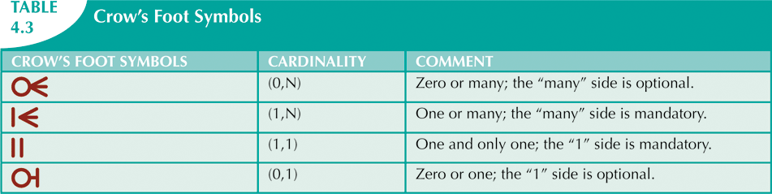

Slide 35
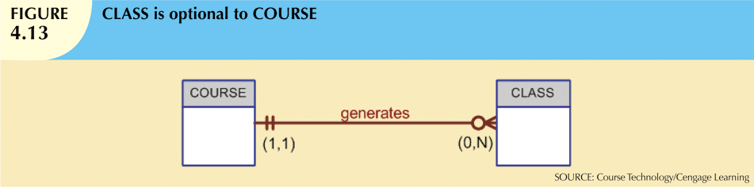
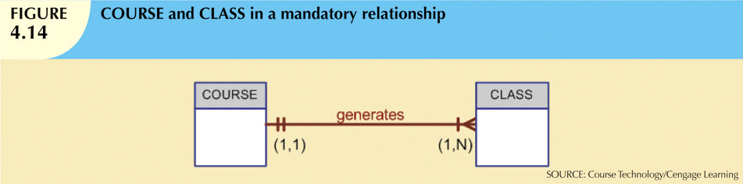

Slide 36
Relationship Degree
Indicates number of entities or participants associated with a relationship
Unary relationship
  Association is maintained within single entity
Binary relationship
  Two entities are associated
Ternary relationship
  Three entities are associated

Slide 37
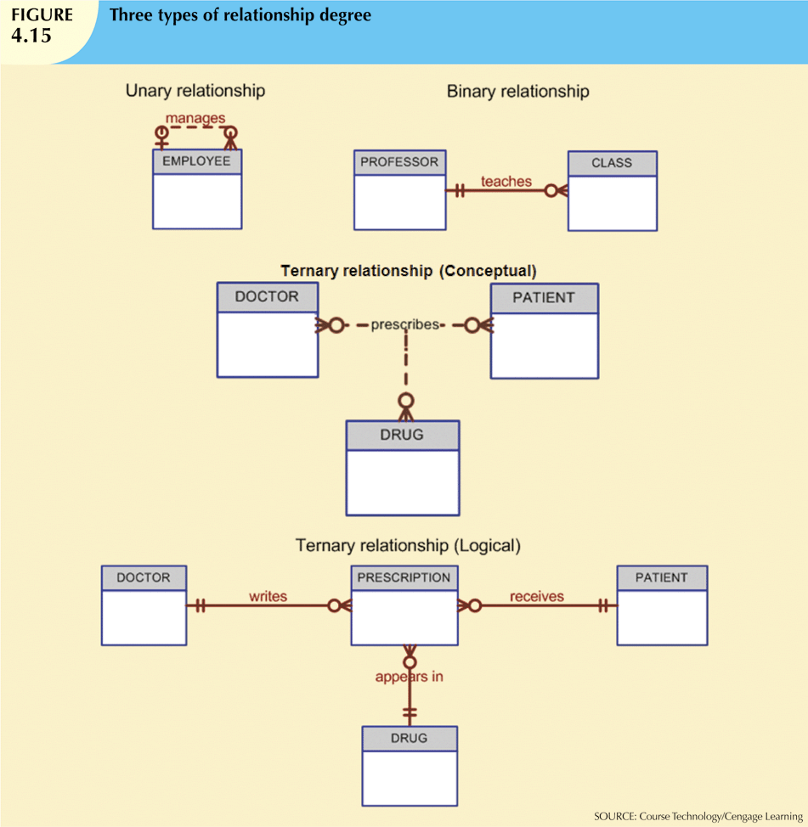

Slide 38
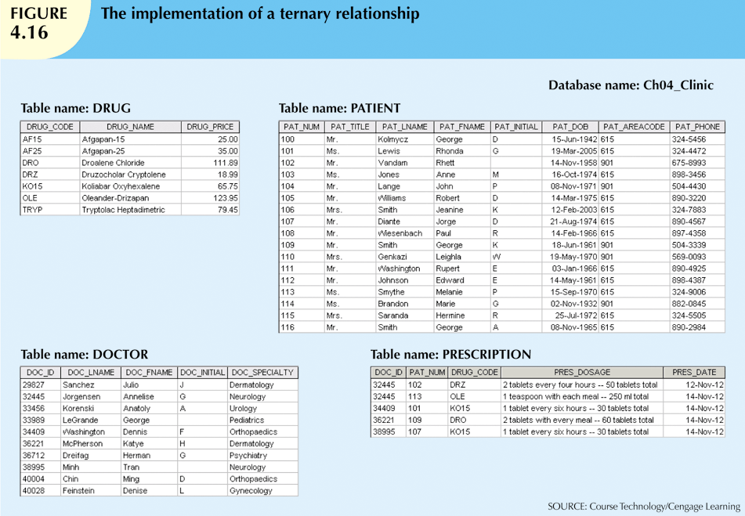

Slide 39
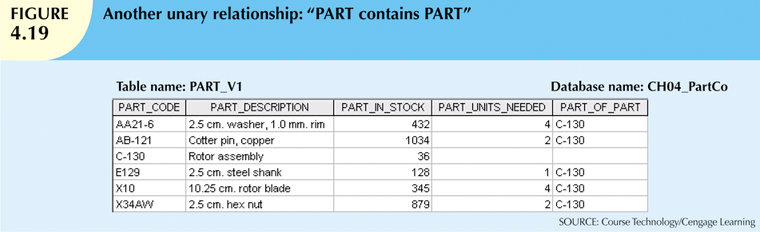
Recursive Relationships
Relationship can exist between occurrences of the same entity set
  Naturally found within unary relationship

Slide 40
Developing an ER Diagram
Database design is an iterative process
  Create detailed narrative of organization’s description of operations
  Identify business rules based on description of operations
  Identify main entities and relationships from business rules
  Develop initial ERD
  Identify attributes and primary keys that adequately describe entities
  Revise and review ERD

Slide 41
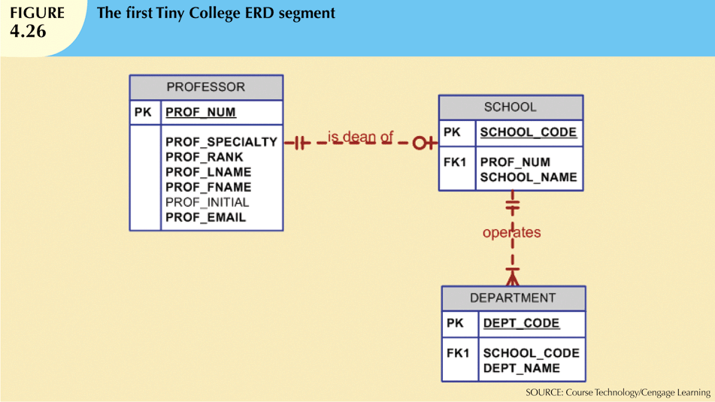
Tiny College (TC) is divided into several schools: business, arts and sciences, education, and applied sciences. Each school is administered by a dean who is a professor. Each professor can be the dean of only one school, and a professor is not required to be the dean of any school. Therefore, a 1:1 relationship exists between PROFESSOR and SCHOOL. Note that the cardinality can be expressed by writing (1,1) next to the entity PROFESSOR and (0,1) next to the entity SCHOOL. Each school comprises several departments.

Slide 42
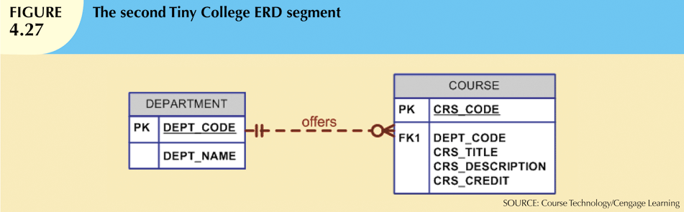
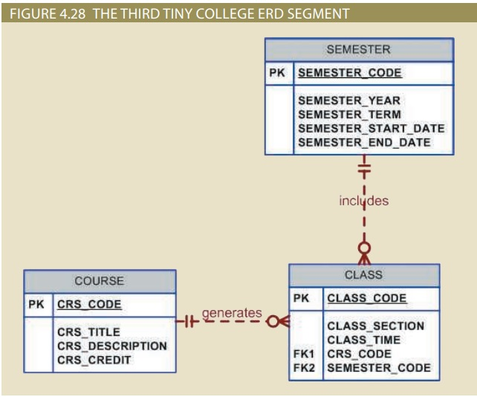
Each department may offer courses. (some only offer research work)
A CLASS is a section of a COURSE. That is, a department may offer several sections (classes) of the same
database course. Each of those classes is taught by a professor at a given time in a given place.
Each class is offered during a given semester. SEMESTER defines the year and the term that the class will be
offered. Note that this is different from the date when the student actually enrolls in a class.

Slide 43
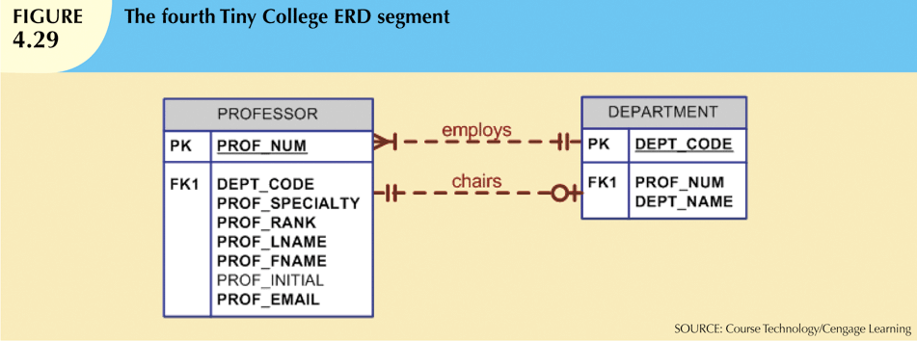
Each department should have one or more professors assigned to it. One and only one of those professors chairs the department, and no professor is required to accept the chair position. Therefore, DEPARTMENT is optional to PROFESSOR in the “chairs” relationship.

Slide 44
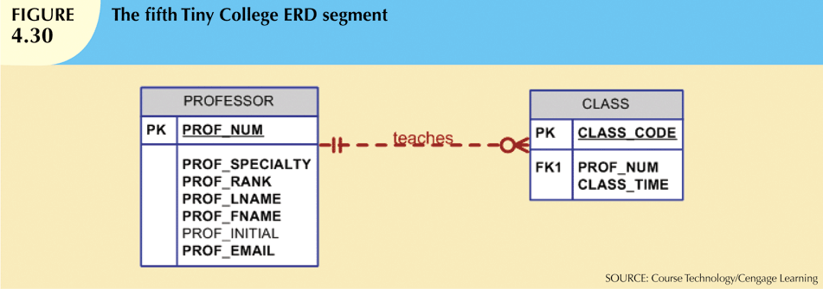
Each professor may teach up to four classes; each class is a section of a course.
A professor may also be on a research contract and teach no classes at all.

Slide 45
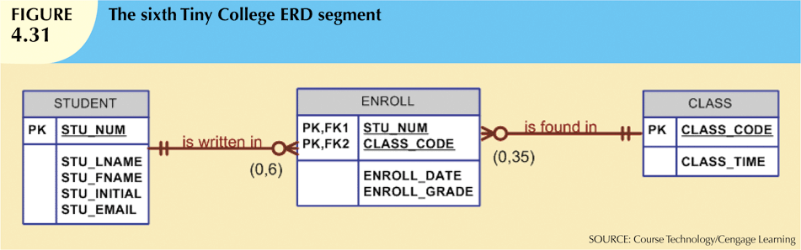
A student may enroll in several classes but take each class only once during any
given enrollment period.

Slide 46
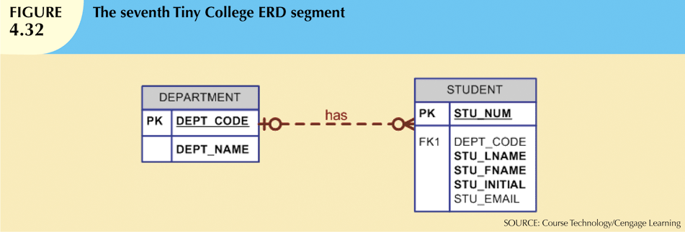
Each department has several (or many) students whose major is offered by that
department. However, each student has only a single major and is therefore
associated with a single department.

Slide 47
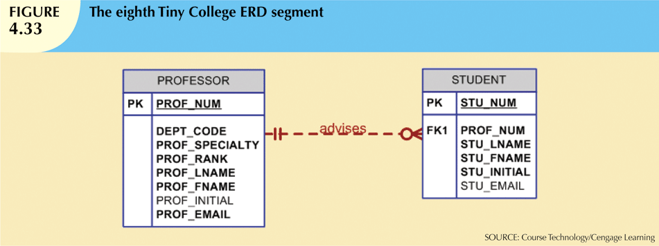
Each student has an advisor in his or her department; each advisor counsels several
students. An advisor is also a professor, but not all professors advise students.
Therefore, STUDENT is optional to PROFESSOR in the “PROFESSOR advises
STUDENT” relationship.

Slide 48
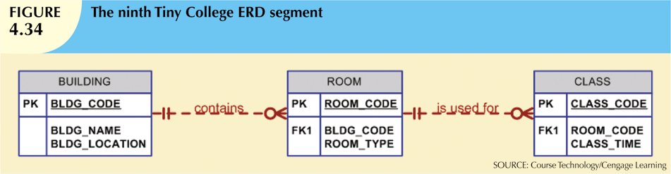
A BUILDING can contain many ROOMs, but each ROOM is found in a single BUILDING.
In this ERD segment, it is clear that some buildings do not contain (class) rooms.
For example, a storage building might not contain any named rooms at all.

Slide 49
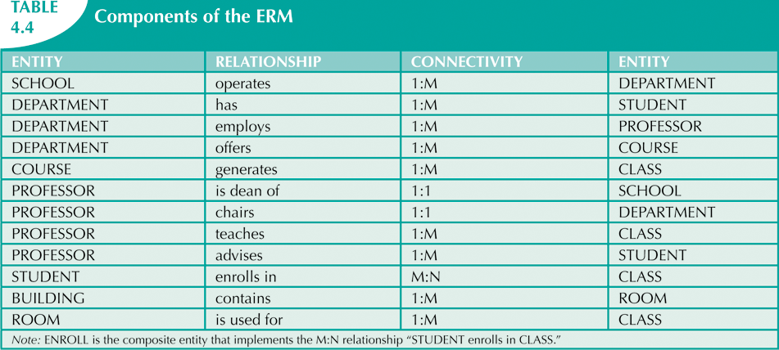

Slide 50
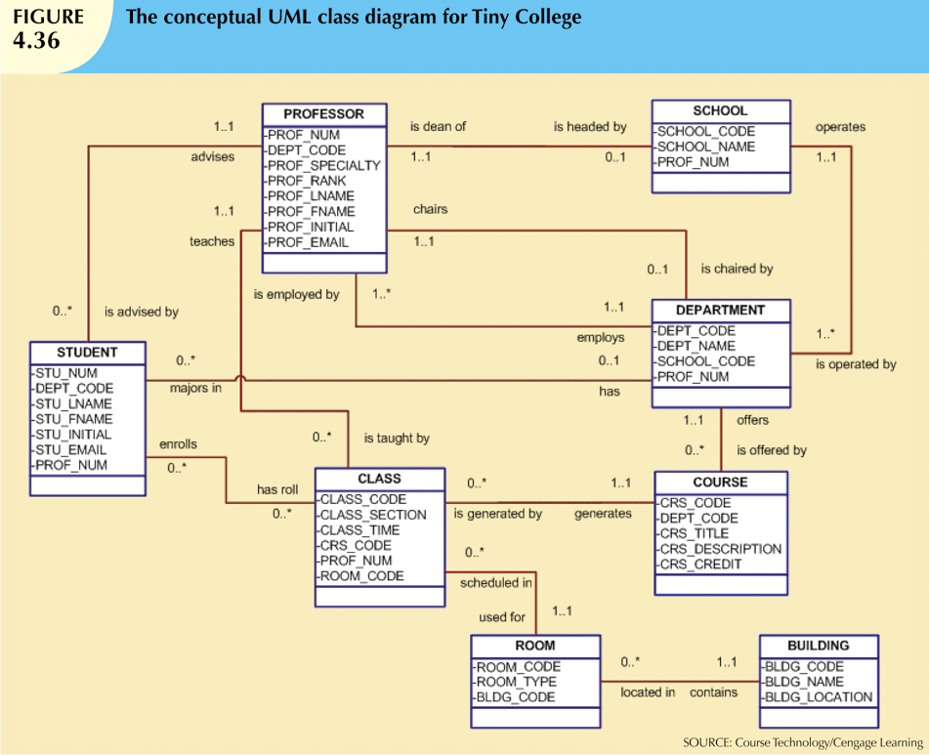

Slide 51
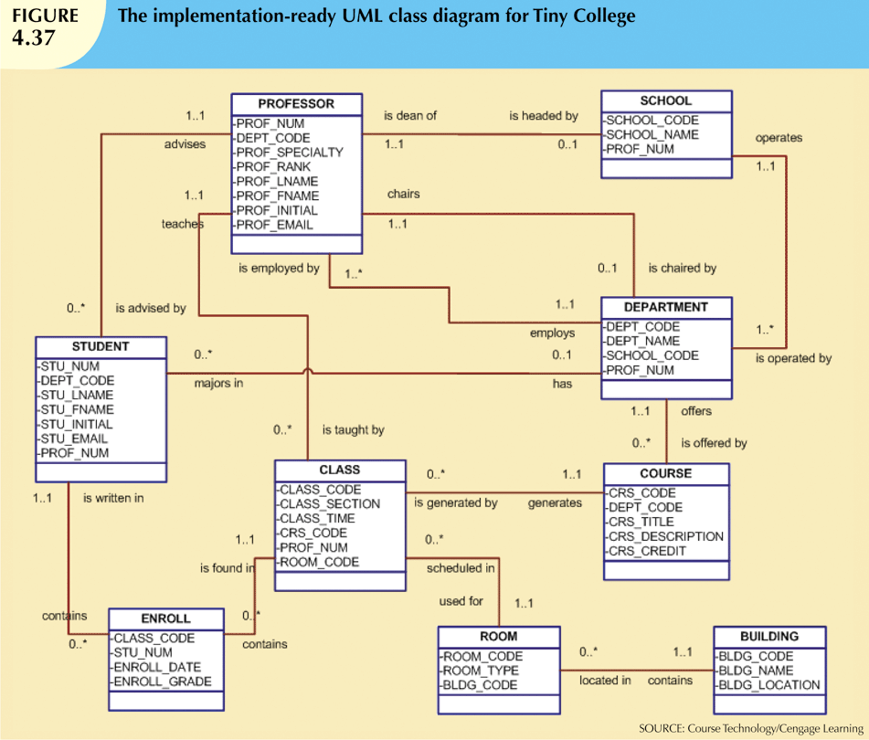

Slide 52
Software to draw ERD
Several software options are available for drawing Entity-Relationship Diagrams (ERDs), and the best choice depends on your preferences, requirements, and platform. Here are some popular options:
Lucidchart:
Lucidchart is a web-based diagramming tool that offers a variety of templates, including ERDs. It supports collaboration and real-time editing, making it suitable for team projects.
Draw.io:
Draw.io is a free, open-source, and web-based diagramming tool. It's user-friendly and supports ERD creation. You can use it online or download it and run it locally.
(link for how to use: https://www.youtube.com/watch?v=lAtCySGDD48)
Microsoft Visio:
Visio is a widely used diagramming tool, especially in business environments. It offers a range of templates, including those for ERDs. Visio is not free, but it's a powerful tool with extensive features.

Slide 53
Exercise
The local city youth league needs a database system to help track children that sign up to play soccer. Data needs to be kept on each team and the children that will be playing on each team and their parents. Also, data needs to be kept on the coaches for each team. Draw the data model described below.
Entities required: Team, Player, Coach, and Parent.
Attributes required:
Team: Team ID number, Team name, and Team colors.
Player: Player ID number, Player first name, Player last name, and Player age.
Coach: Coach ID number, Coach first name, Coach last name, and Coach home phone number.
Parent: Parent ID number, Parent last name, Parent first name, Home phone number, and Home Address (Street, City, State, and ZIP Code).

Slide 54
The following relationships must be defined:
Team is related to Player.
Team is related to Coach.
Player is related to Parent.
Connectivities and participations are defined as follows:
A Team may or may not have a Player.
A Player must have a Team.
A Team may have many Players.
A Player has only one Team.
A Team may or may not have a Coach.
A Coach must have a Team.
A Team may have many Coaches.
A Coach has only one Team.
A Player must have a Parent.
A Parent must have a Player.
A Player may have many Parents.
A Parent may have many Players.

